Slide 1
Boolean Algebra

Slide 2
Boolean variable:
Let B = {0, 1}. The variable x is called a Boolean variable if it assumes values only from B.
Boolean function:
A function from B^{n}, the set {(x₁, x₂, …, x_{n}) |x_{i}∈B, 1 ≤ i ≤ n}, to B is called a Boolean function of degree n.
The complement, Boolean sum, and Boolean product correspond to the logical operators ,¬ ,∨, and ∧, respectively, where 0 corresponds to F (false) and 1 corresponds toT (true).

Slide 3
Complement:
The complement is denoted by a bar. It is defined by
Boolean sum:
The Boolean sum, denoted by + or by OR, has the following values:
1 + 1 = 1, 1 + 0 = 1, 0 + 1 = 1, 0 + 0 = 0
Boolean product:
The Boolean product, denoted by ⋅ or by AND, has the following values:
1 ⋅ 1 = 1, 1 ⋅ 0 = 0, 0 ⋅ 1 = 0, 0 ⋅ 0 = 0

Slide 4

Translate into a logical equivalence.
Solution:
(T ∧ F) ∨¬(T ∨ F) ≡ F.
Translate the logical equivalence (T ∧ T) ∨¬F ≡ T into an identity in Boolean algebra.
Solution:

Slide 5
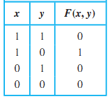
The function from the set of ordered pairs of Boolean variables to the set {0, 1} is a Boolean function of degree 2 with F(1, 1) = 0, F(1, 0) = 1, F(0, 1) = 0, and F(0, 0) = 0.

Slide 6
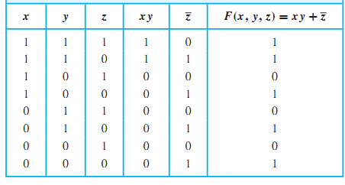
Each Boolean expression represents a Boolean function. The values of this function are obtained by substituting 0 and 1 for the variables in the expression.
Find the value of the Boolean function represented by

Slide 7
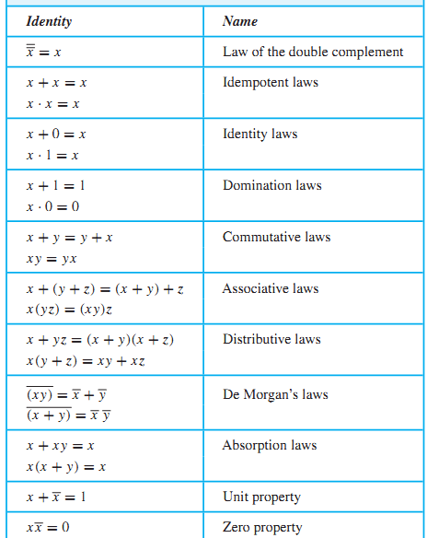

Slide 8
Prove the absorption law x(x + y) = x
x(x + y) = (x + 0)(x + y) Identity law
= x + 0 · y Distributive law
= x + y · 0 Commutative law
= x + 0 Domination law
= x Identity law

Slide 9
Boolean functions F and G of n variables are equal if and only if F(b₁, b₂, …, b_{n}) = G(b₁, b₂, …, b_{n}) whenever b₁, b₂, …, b_{n}belong to B.
Two different Boolean expressions that represent the same function are called equivalent.
Example: Boolean expressions xy, xy + 0, and xy · 1 are equivalent.

Slide 10
Question: How many different Boolean functions of degree n are there?
Solution:
There are 2^{n} different n-tuples of 0s and 1s.
A Boolean function is an assignment of 0 or 1 to each of these 2^{n} different n-tuples.
Therefore, there are 2^{2n} different Boolean functions.

Slide 11
Question: How many different Boolean functions of degree 1 and degree two are there?
Solution: Four of degree 1 and Sixteen of degree 2
x | F₁ | F₂ | F₃ | F₄
0 | 0 | 0 | 1 | 1
1 | 0 | 1 | 0 | 1
x | y | F₁ | F₂ | F₃ | F₄ | F₅ | F₆ | F₇ | F₈ | F₉ | F₁₀ | F₁₁ | F₁₂ | F₁₃ | F₁₄ | F₁₅ | F₁₆
0 | 0 | 0 | 0 | 0 | 0 | 0 | 0 | 0 | 0 | 1 | 1 | 1 | 1 | 1 | 1 | 1 | 1
0 | 1 | 0 | 0 | 0 | 0 | 1 | 1 | 1 | 1 | 0 | 0 | 0 | 0 | 1 | 1 | 1 | 1
1 | 0 | 0 | 0 | 1 | 1 | 0 | 0 | 1 | 1 | 0 | 0 | 1 | 1 | 0 | 0 | 1 | 1
1 | 1 | 0 | 1 | 0 | 1 | 0 | 1 | 0 | 1 | 0 | 1 | 0 | 1 | 0 | 1 | 0 | 1

Slide 12
Boolean algebra :
A Boolean algebra is a set B with two binary operations ∨ and ∧, elements 0 and 1, and a unary operation – such that the following properties hold for all x, y, and z in B:
x ∨ 0 = x and x ∧ 1 = x (identity laws)
(domination laws)
(x ∨ y) ∨ z = x ∨ (y ∨ z) (x ∧ y) ∧ z = x ∧ (y ∧ z) (associative laws)
x ∨ y = y ∨ x and x ∧ y = y ∧ x (commutative laws)
x ∨ (y ∧ z) = (x ∨ y) ∧ (x ∨ z) x ∧ (y ∨ z) = (x ∧ y) ∨ (x ∧ z) (distributive laws)

Slide 13
Dual:
The dual of a Boolean expression is obtained by interchanging Boolean sums and Boolean products and interchanging 0s and 1s.
The dual of x(y + z) is x + yz.
The dual of is

Slide 14
Example:
Give a Boolean expression for the Boolean function F(x,y) as defined by the following table:
x | y | F(x, y)
0 | 0 | 0
0 | 1 | 1
1 | 0 | 0
1 | 1 | 0
Possible Solution: F(x, y) =

Slide 15
Example: Give a Boolean expression satisfying F(x,y,z)=1 if and only if:
x = y = z = 0 or
x = y = 0, z = 1 or
x = 1, y = z = 0
Solution:
x | y | z | F(x,y,z)
1 | 1 | 1 | 0
1 | 1 | 0 | 0
1 | 0 | 1 | 0
1 | 0 | 0 | 1
0 | 1 | 1 | 0
0 | 1 | 0 | 0
0 | 0 | 1 | 1
0 | 0 | 0 | 1

Slide 16
Literal: A literal is a Boolean variable or its complement.
Minterm: A minterm of the Boolean variables x₁, x₂, …, x_{n} is a Boolean product y₁y₂…y_{n}, where or
Example:
Find a minterm that equals 1 if x₁=x₃= 0 and x₂=x₄=x₅=1, and equals 0 otherwise.
Solution:

Slide 17
A Boolean sum of minterms has the value 1 when exactly one of the minterms in the sum has the value 1. It has the value 0 for all other combinations of values of the variables.
Given a Boolean function, a Boolean sum of minterms can be formed that has the value 1 when this Boolean function has the value 1, and has the value 0 when the function has the value 0.
The sum of minterms that represents the function is called the sum-of-products expansion or the disjunctive normal form of the Boolean function.

Slide 18
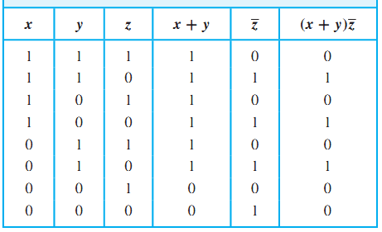
Find the sum-of-products expansion for the function
Solution:

Slide 19
Maxterm: A maxterm of the Boolean variables x₁, x₂, …, x_{n} is a Boolean sum y₁+y₂+…+y_{n}, where or
A Boolean expression that represents a Boolean function by taking a Boolean product of maxterms is called the conjunctive normal form or product-of-sums expansion of the function.

Slide 20
Find the product-of-sums expansion for the function
Solution:

Slide 21
Karnaugh Maps
Karnaugh map or k-map is a graphical approach used to minimize a given Boolean expression.
There are four possible minterms in the sum-of-products expansion of a Boolean function in two variables x and y. A K-map for a Boolean function in these two variables consists of four cells.
1 is placed in the cell representing a minterm if this minterm is present in the expansion otherwise a 0 is placed in the cell.
Cells are said to be adjacent if the minterms that they represent differ in exactly one literal.

Slide 22
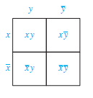
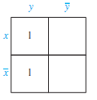
Karnaugh map of two variables
Find the K-maps for i)

Slide 23
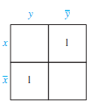
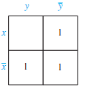
ii)
iii)

Slide 24
Identifying minterms that can be combined from the K-map
Search for 1s in two adjacent cells in the K-map.
The minterms represented by these cells can be combined
into a product involving just one of the variables. For instance, and are represented by adjacent cells and can be combined into .

Slide 25
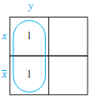
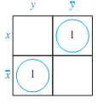
Simplify the sum-of-products expansion of
i)
ii)
iii)
i)
Answer: y
ii)
Answer:

Slide 26
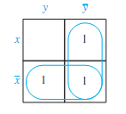
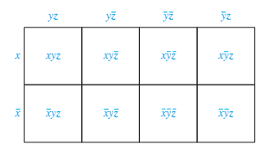
iii)
Answer:
A K-map in three variables is a rectangle divided into eight cells. The cells represent the eight possible minterms in three variables.

Slide 27
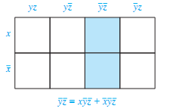
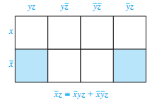
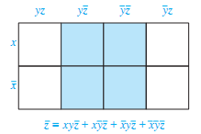
To simplify a sum-of-products expansion in three variables, we use the K-map to identify blocks of minterms that can be combined.
Examples

Slide 28
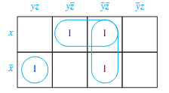
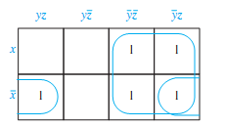
Use k-maps to minimize the following sum-of-products expansions:
Answer:
Answer:

Slide 29
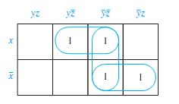
Answer:

Slide 30
NAND operator:
| or NAND operator is deﬁned by
1 | 1 = 0 and 1 | 0 = 0 | 1 = 0 | 0 = 1
NOR operator:
↓ or NOR operator is deﬁned by
1 ↓ 1 = 1 ↓ 0 = 0 ↓ 1 = 0 and 0 ↓ 0 = 1

Slide 31
TYPES OF GATES
Boolean algebra is used to model the circuitry of electronic devices.
The basic elements of circuits are called gates.
Inverter or NOT Gate
x | F
0 | 1
1 | 0
Accepts the value of one Boolean variable as input and produces the complement of this value as output.

Slide 32
AND Gate
x | y | F
0 | 0 | 0
0 | 1 | 0
1 | 0 | 0
1 | 1 | 1
The inputs to this gate are 2 or more Boolean variables. The output is the Boolean product of their values.

Slide 33
OR Gate
x | y | F
0 | 0 | 0
0 | 1 | 1
1 | 0 | 1
1 | 1 | 1
The inputs to this gate are the values of 2 or more Boolean variables. The output is the Boolean sum of their values.

Slide 34
NAND Gate
x | y | F
0 | 0 | 1
0 | 1 | 1
1 | 0 | 1
1 | 1 | 0
NOR Gate
x | y | F
0 | 0 | 1
0 | 1 | 1
1 | 0 | 1
1 | 1 | 0

Slide 35
XOR Gate
x | y | F
0 | 0 | 0
0 | 1 | 1
1 | 0 | 1
1 | 1 | 0
XNOR Gate
x | y | F
0 | 0 | 1
0 | 1 | 0
1 | 0 | 0
1 | 1 | 1

Slide 36
Combinations of Gates:
Combinational circuits can be constructed using a combination of inverters, OR gates, and AND gates.
Example:
Construct circuits that produce the following outputs:
i)
ii)

Slide 37
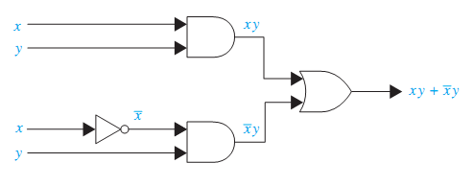
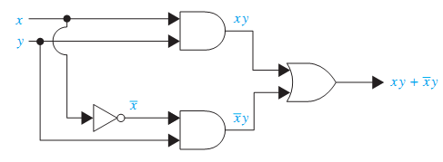
i) Following are two alternatives to draw the circuit

Slide 38
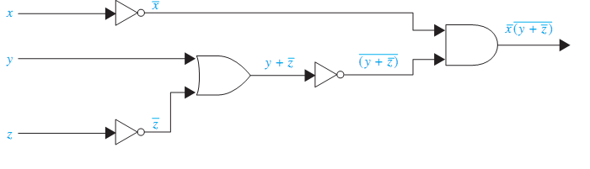
ii)

Slide 39
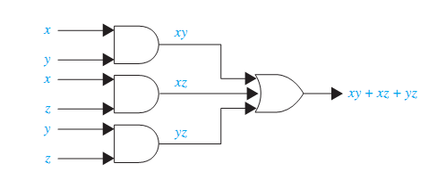
Example:
A committee of three individuals decides issues for an organization. Each individual votes either yes or no for each proposal that arises. A proposal is passed if it receives at least two yes votes. Design a circuit that determines whether a proposal passes.

Slide 40


Circuit Diagrams f0r and x+y using NAND operator

Slide 41
Minimization of Circuits:
The efficiency of a combinational circuit depends on the number and arrangement of its gates. Terms in a sum-of-products expansion that differ in just one variable, so that in one term this variable occurs and in the other term the complement of this variable occurs, can be combined.
For example:
Hence, xz is a Boolean expression with fewer operators that represents the circuit.

Slide 42
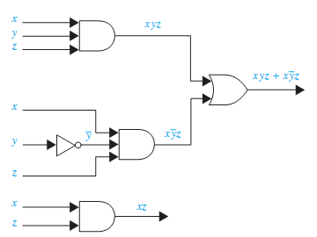
Circuit diagrams with same output:

